Slide 1
SHOT DIVISION
Yadukrishnan SP

Slide 2
Breaking down a script
Frame
Shot
Scene
Sequence

Slide 3
Shot
Shots are the units that make a film.
once the screenplay is ready, we have to finally go through this exercise, of dividing each scene into shots.
We have to consider some basic film making rules and techniques.

Slide 4
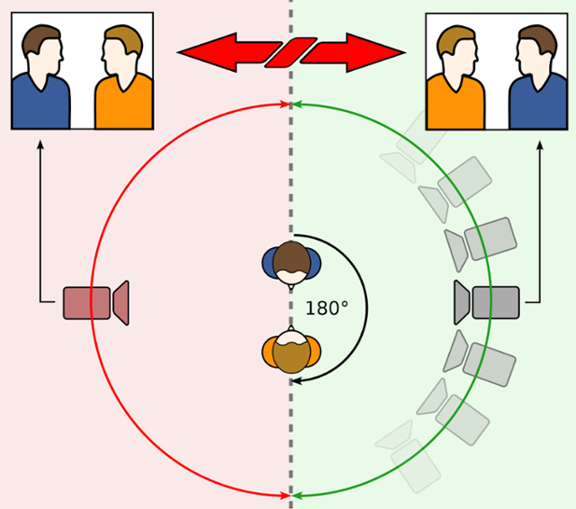
180 Degree Rule

Slide 5
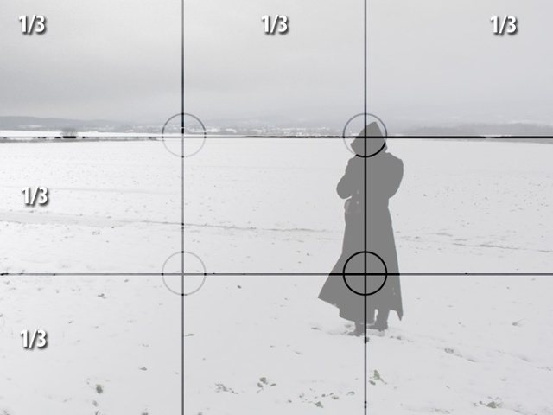
The Rule of Thirds

Slide 6


Head Room and Nose Room

Slide 7
Rules are meant to be broken

Slide 8
Ask these questions before breaking down your scene
Whose scene is it? (Which characters’)
What is the purpose of the scene? (Narrative and/or dramatic, expository, to create a mood, to shed more light on characters etc.)
What are the Dramatic Blocks that constitute the scene?

Slide 9
Types of shots, camera angles, camera movements

Slide 10
Example from “No Country For Old Men”

Slide 11
Assignment
The hero while wandering outside his village finds out a signboard at the border of the village and forest. In that border there is a warning message from bandits in a sign board saying that they will plunder their village today night. How will the hero inform this information to his villagers? Suggest a method which is more powerful and dramatic.
Write a screenplay for this scenario.
Create shot list for the screenplay.

